Slide 1

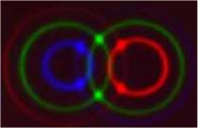


QUANTUM
TELEPORTATION
SYMPOSIUM OF NANOSCIENCE “TRANSPORT ON THE EDGE”
18 June 2004

Slide 2

Introduction
Quantum teleportation: transfer of the information of an object without sending the object itself
Why does it work?
  Debate in quantum mechanics
How does it work?
  Realization
  'Star Trek' teleporter nearer reality
June 17, 2002 Posted: 12:47 AM EDT (0447 GMT)
CANBERRA, Australia -- It's not quite "Star Trek" yet, but Australian university researchers in quantum optics say they have "teleported" a message in a laser beam using the same technology principles that enabled Scotty to beam up Captain Kirk.
CANBERRA, Australia -- It's not quite "Star Trek" yet, but Australian university researchers in quantum optics say they have "teleported" a message in a laser beam using the same technology principles that enabled Scotty to beam up Captain Kirk.

Slide 3
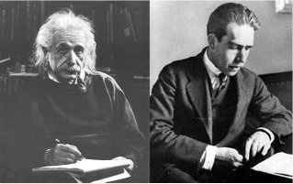
Let’s Meet Our Key Figures
God does not play dice with the
universe -Albert Einstein
Anyone who is not shocked by Quantum
Theory has not understood it -Niels Bohr

Slide 4
The EPR Paradox: Non-locality in Quantum Mechanics
1935: Paper by Einstein, Podolsky, and Rosen stating a paradox in quantum mechanics
Quantum mechanics is a local, but incomplete theory
There might be so-called hidden variables that complete quantum mechanics
Locality: No instantaneous interaction between distant systems
Einstein, A., Podolsky, B., Rosen, N. (1935) Physical Review 47, 777-780

Slide 5
The EPR Paradox: Idea
Assumptions:
-Quantum theory is local
- Wave function forms complete description
Two particle quantum system:
Neither position nor momentum of either particle is well defined, sum of positions and difference of momenta are precisely defined
Quantum mechanics:
Two non commuting quantities (e.g. position and momentum) can not have a precisely defined value simultaneously
Measurement:
Knowledge of e.g. the position of particle 1, gives the precise position of particle 2 without interaction, position and momentum can be simultaneously defined properties of a system
Paradox

Slide 6


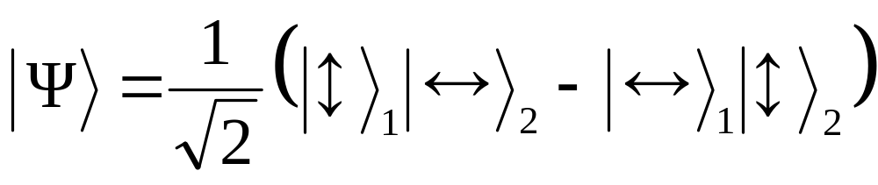
Experimental Realization of the Paradox I
source
-1
-1
+1
+1
θ
photon 1
photon 2
φ
Two entangled photons 1 and 2 emitted from a source impinge on polarizing analyzers
Test with polarization entangled photons
Entanglement: creation in same process, interaction
No product state but superposition
Adapted from: Bohm, D., Aharonov, Y. (1957) Physical Review 108, 1070-1076

Slide 7
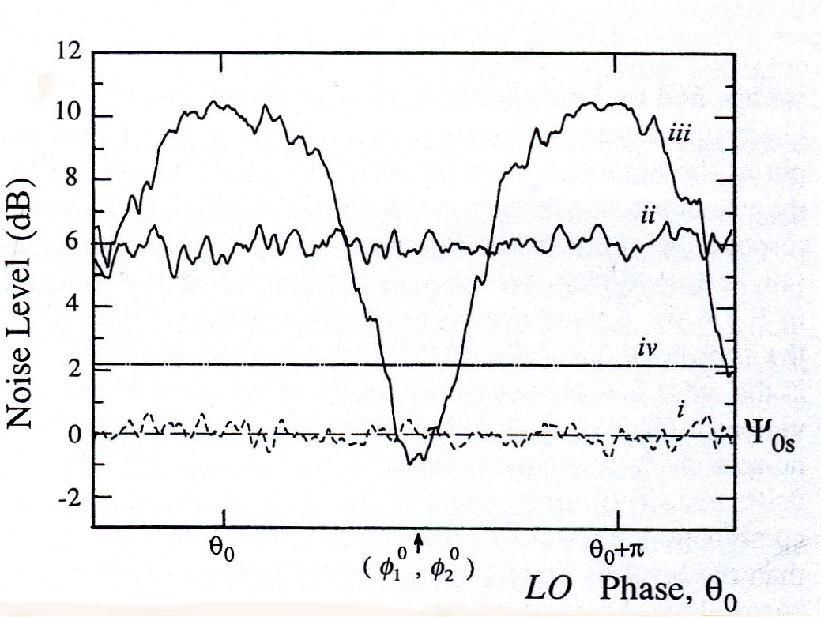
Experimental Realization of the Paradox II
Violation of Heisenberg’s principle if correlation noise has values below zero; confirmation of paradox
For some phases the noise is lower than zero
The phase sensitive noise (iii) for some phases (φ₁⁰, φ₂⁰) was lower than the noise level of the signal beam alone (i) implying violation of Heisenberg’s principle
Ou, Z.Y., Pereira, S.F., Kimble, H.J. (1992) Applied Physics B 55, 265-278

Slide 8
Solution to the Paradox
1964: J. Bell states inequalities for hidden variable theories
Inequalities correct: local hidden variables, quantum mechanics is local
Inequalities incorrect: no hidden variables, quantum mechanics is complete and non-local
P(a,b): Expectation value of the measurement outcomes
Bell, J.S. (1964) Physics 1, 195-200; Clauser et. Al. (1969) Physical Review Letters 23,880-884

Slide 9
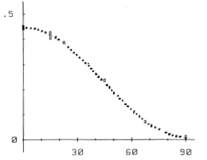
Is Quantum Mechanics Complete
Experiments showed Bell’s inequalities to be incorrect
No hidden variables: quantum mechanics is complete and non-local
Non-locality essential idea for quantum teleportation
Average coincidence rate as a function of the relative orientations of the polarisers. The dashes line is the quantum mechanical prediction and shows excellent agreement with the experiment.
Aspect, A., Dalibard, J., Roger, G. (1982) Physical Review Letters 49, 1804-1807

Slide 10
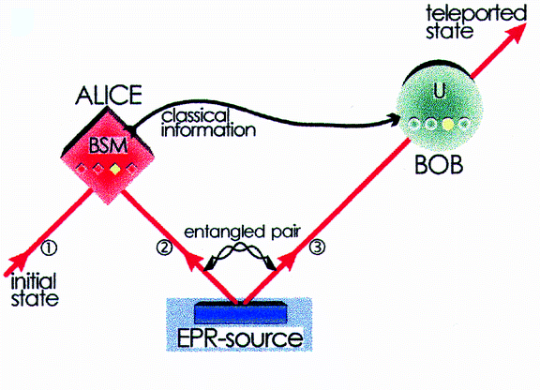
Quantum Teleportation
Correlations used for data transfer
Teleporting the state not the particle
Entanglement between photon 1 and 2
Bell state measurement causes teleportation
Schematic idea for quantum teleportation introducing Alice as a sending and Bob as a receiving station, showing the different paths of information transfer.
Bouwmeester, D., et. Al. (1997) Nature 390, 575-579

Slide 11
Entangled States
Parametric down-conversion
Non-linear optical process
Creation of two polarization entangled photons
Pulsed beams
E₁
ω
k⁽¹⁾_{ω}
Pump
ω_{p} = ω + ω
E_{p}
ω_{p}
k_{ωp}= k⁽¹⁾_{ω}+ k⁽²⁾_{ω}
k_{ωp}
E_{p}= χ⁽²⁾E₁.E₂*
ω
k⁽²⁾_{ω}
χ⁽²⁾
E₂
Parametric down-conversion creating a signal and idler beam from the pump-pulse. Energy and momentum conservation are shown on the right side.

Slide 12
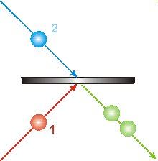
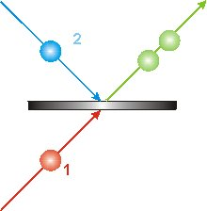
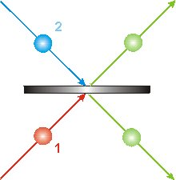
Bell State Measurement
Projects onto the Bell states and entangles photons
Use of a polarizing beamsplitter
  transmits vertically polarized light
  reflects horizontally polarized light
There are four possible outcomes of the beamsplitter that can be determined by putting detectors in their paths. In the lower image it can not be said which photon is which; they are entangled

Slide 13
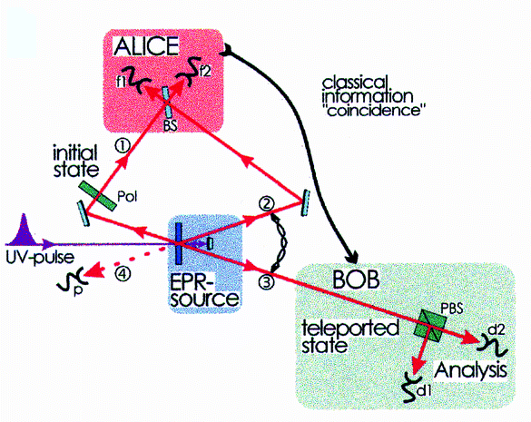
Experimental Realization
UV pulse beam hits non-linear crystal twice
Threefold coincidence f₁f₂d₁(+45°) in absence of f₁f₂d₂ (-45°)
Temporal overlap between photon 1,2
Experimental set-up for quantum teleportation, showing the UV pulsed beam that creates the entangled pair, the beamsplitters and the polarisers.
Bouwmeester, D.,et. Al. (1997) Nature 390, 575-579

Slide 14
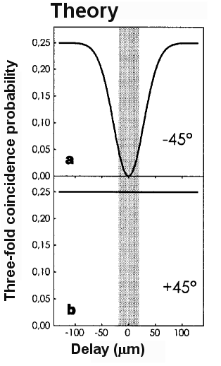
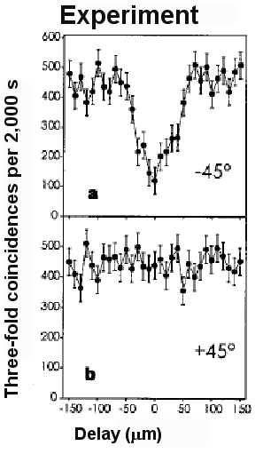
Experimental Demonstration
Theoretical and experimental threefold coincidence detection between the two Bell state detectors f₁f₂ and one of the detectors monitoring the teleported state. Teleportation is complete when d₁f₁f₂ (-45°) is absent in the presence of d₂f₁f₂(+45°) detection.
Bouwmeester, D., et. Al. (1997) Nature 390, 575-579

Slide 15
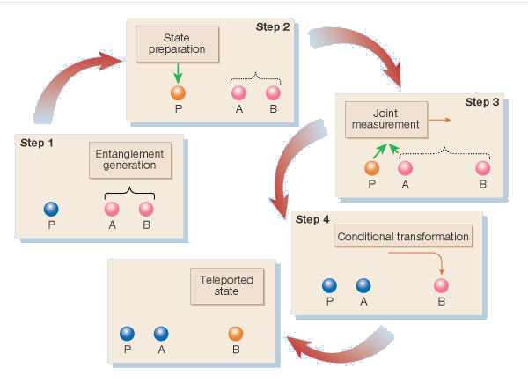
Teleportation of Massive Particles
Quantum teleportation step by step following the original protocol
Kimble, H.J., Van Enk, S.J. (2004) Nature 429, 712-713

Slide 16

Conclusion
Promising technique, still to be optimized
“Beam me up, Scotty” reality?
  10⁰ vs. 10²⁹ atoms
  fidelity not 100%
Use as data transport in quantum communication
  quantum cryptography
  quantum dense coding
Quantum computing

